Slide 1
Machine Learning Workshop
---- Data Science Community Workshop Series
Institute of Data Science
24-04-2018

Slide 2
Chang Sun
PhD candidate at Institute of Data Science at Maastricht University 🇳🇱
Master degree in Artificial Intelligence at DKE at Maastricht University 🇳🇱
Bachelor degree in Electrical Engineering at Shanghai Maritime University 🇨🇳
Research interests: distributed machine learning, privacy-preserving machine learning, resource description framework, ontology…

Slide 3
Pedro Hernandez
Data Scientist at Institute of Data Science at Maastricht University
Background in Mathematics, Statistics and Computer Science
Developed for Government, Health Startups, Insurance companies
Research interests: Reproducible Research, Autonomous Systems, Graph Analytics

Slide 4
Introduction
Who are you?
What’s your background?
Where are you going to use machine learning?

Slide 5
Agenda:
Morning:
10:00 - 10:30 History of Machine Learning
10:30 - 10:50 Warming up
11:00 - 11:40 Approaches of Machine Learning
11:40 - 12:00 Practical problems
Afternoon:
13:00 - 13:20 Use cases
13:20 - 14:20 Hands-on
14:20 - 15:00 Discussion and closing

Slide 6
History of Machine Learning

Slide 7
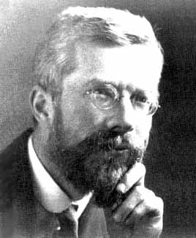
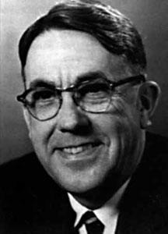
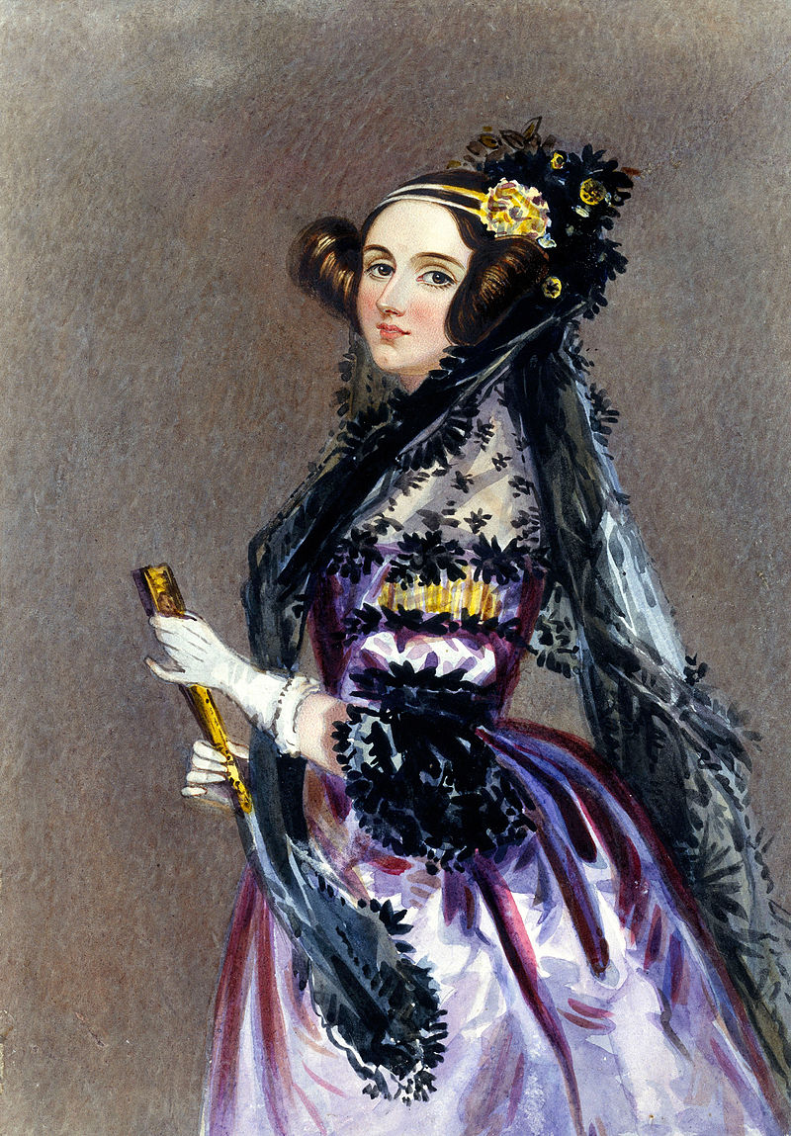
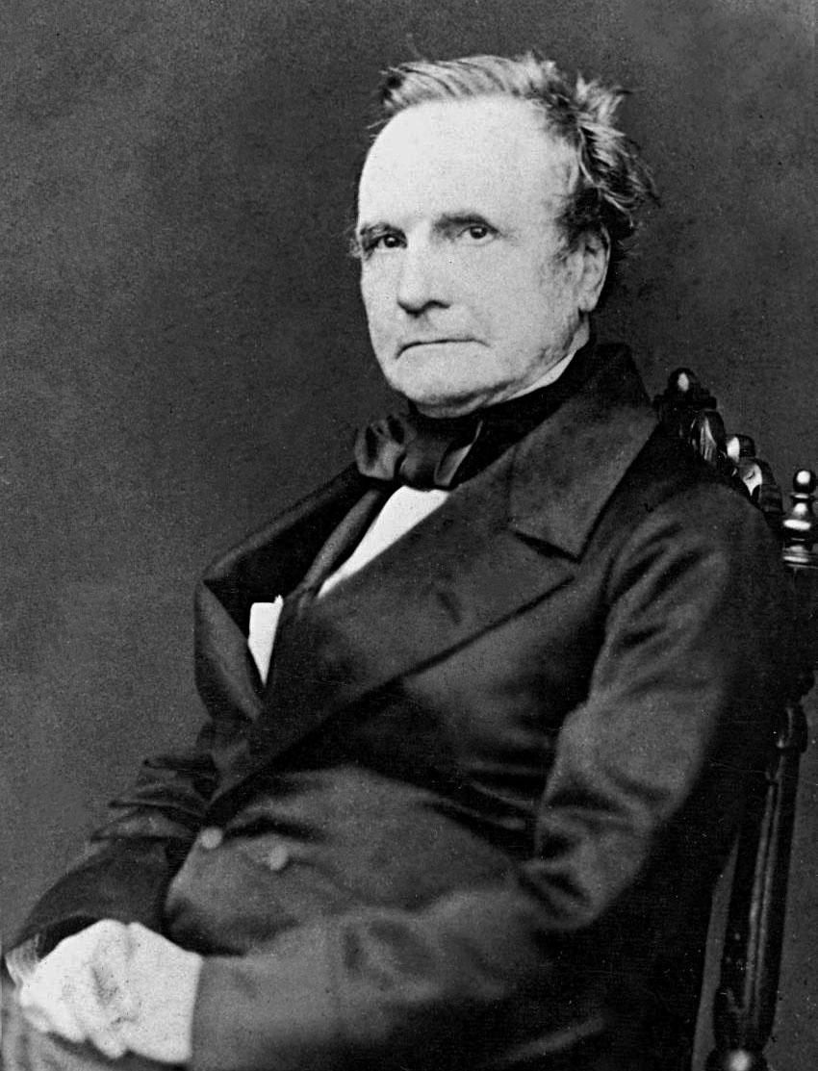
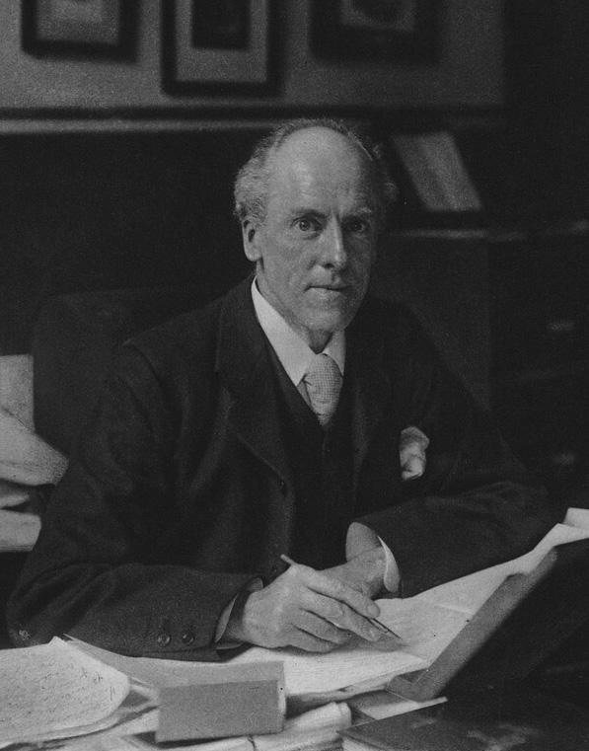

Founders
Fisher’s
Information
Machine
Learning
First Programmer
Charles Babbage
Year: 1837
Karl Pearson
Year: 1893
Alan Turing
Year: 1943
Ada Lovelace
Year: 1843
Ronald Fisher
Year: 1918
Arthur Samuel
Year: 1959
Analytical Engine
Modern statistics
Intelligent
Machine

Slide 8
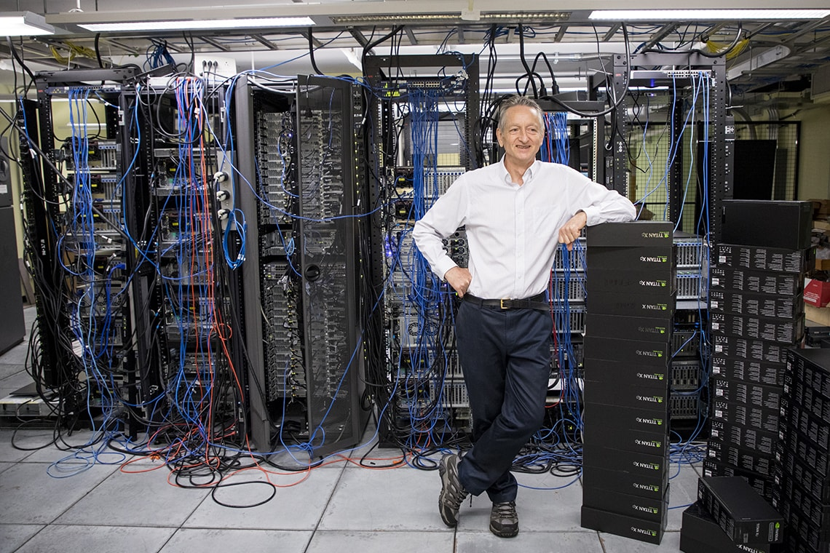
We are standing on the shoulders of giants
Geoffrey Hinton
Father of Deep Learning

Slide 9
History of Machine Learning
Boom Period
Year: 1960
Expert System
Year: 1980
?
What do you think about now?
Deep Blue,
Deep Learning,
Face recognition,
AlphaGo,
Self-driving car
… …
1st AI Winter
Year: 1974-1980
2st AI Winter
Year: 1987-1993

Slide 10
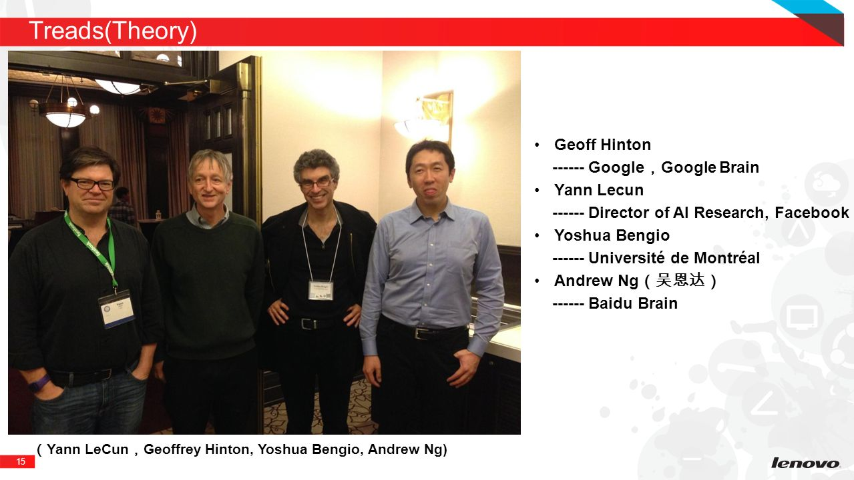
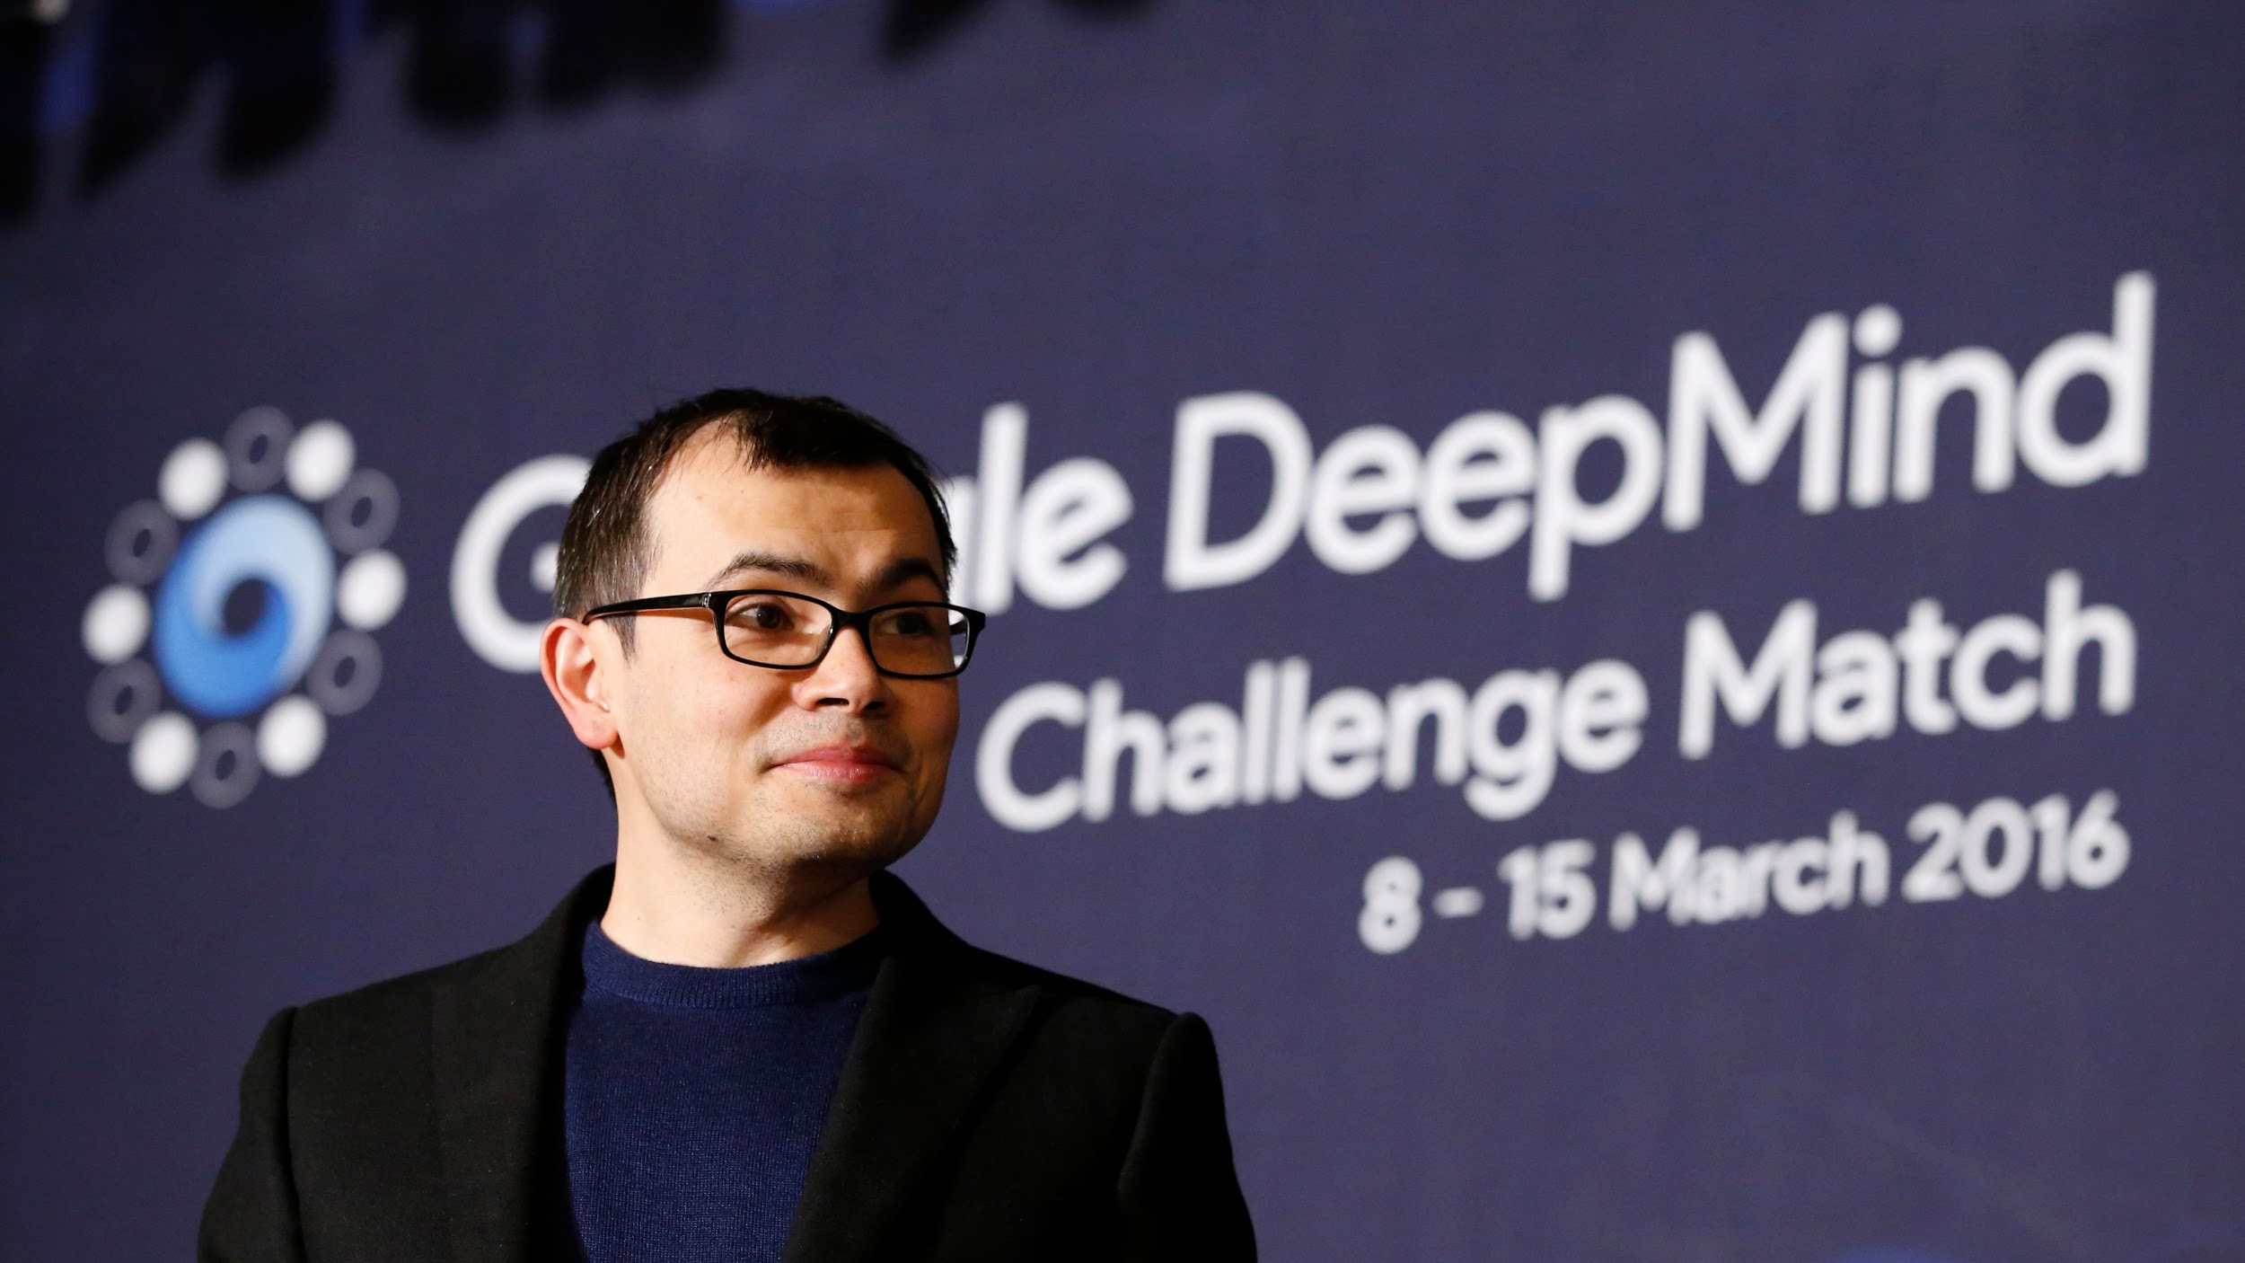
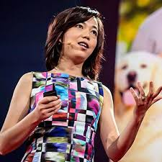
Demis Hassabis
-- Google DeepMind
Yoshua Bengio
-- Université de Montréal
Yann Lecun
-- Director of
AI Research, Facebook
Geoffery Hinton
-- Google Brain
Andrew Ng （吴恩达）
-- Coursera, deeplearning.ai
Fei-fei Li
-- Google Cloud
Notes:
Yann – the founding father of convolutional neural networks
Geoffery – Godfather of deep learning, came up with artificial neural networks
Yohua -- most noted for his work on artificial neural networks and deep learning
Andrew --
Demis – co-found the deepmind who created alpha Go
Fei-fei -- her best-known work is the ImageNet project, which has revolutionized the field of large-scale visual recognition

Slide 11
Current state of Machine Learning
Current definition: computer science + statistical techniques
Development: multiple choices of programming languages
Practice: diverse machine learning tools
Application:
Recommendation on Booking, Netflix, LinkedIn …
Virtual personal assistant / customer support ...
Fraud detection / abnormal detection …
Identifying skin / breast cancers …

Slide 12
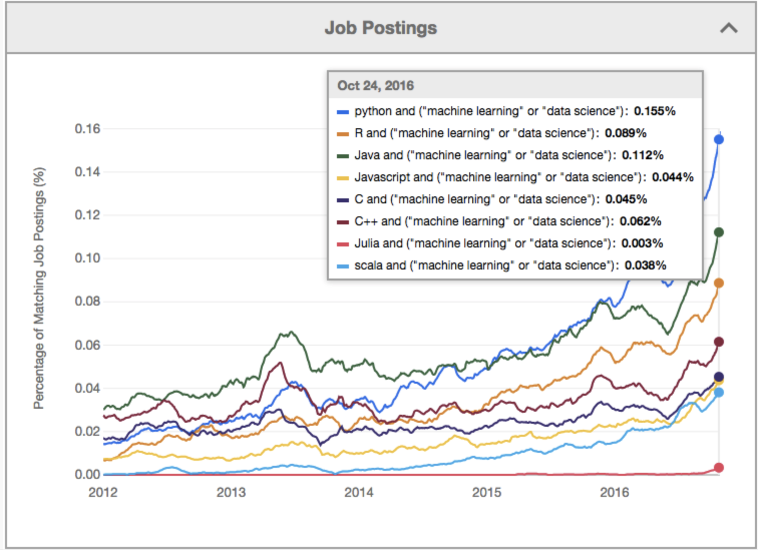
Multiple choices of programming languages
Python
Java
R
C++
Javascript
Scala
2017 KDNuggets - The Most Popular Language For Machine Learning and Data Science Is …

Slide 13
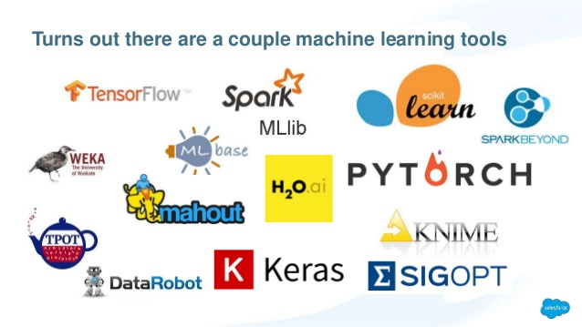
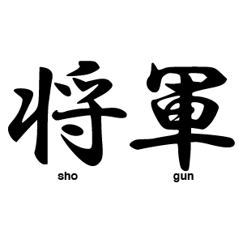

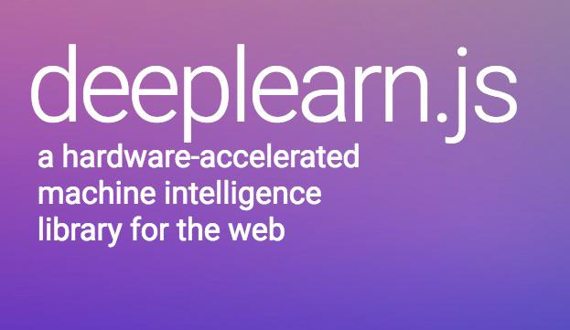
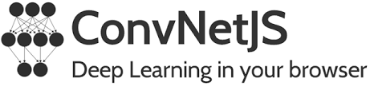
Diverse machine learning tools
They are making your life much easier !
Notes:
Why do they make your life easier?
Weka: a collection of machine learning algorithms for data mining tasks https://www.cs.waikato.ac.nz/ml/weka/
KNIME:
Tensorflow: Created by Google Brain for internal google use. Released in 2015, it is a symbolic math library, and is also used for machine learning applications such as neural networks. www.tensorflow.org
Spark MLlib: Usable in Java, Scala, Python, and R, It is a Spark library, so you need to use Spark first then this library. Apache Spark is an open-source cluster-computing framework. https://spark.apache.org/mllib/
Scikit Learn: a free software machine learning library for the Python programming language. http://scikit-learn.org/stable/
Turicreate: Turi Create simplifies the development of custom machine learning models. You don't have to be a machine learning expert. https://github.com/apple/turicreate
H2O.ai: H2O.ai makes machine learning accessible and allows business users to extract insights from data, without needing expertise in deploying or tuning machine learning models https://www.h2o.ai/
PYTORCH: PyTorch is an open source machine learning library for Python, based on Torch. It provides a wide range of algorithms for deep learning. http://pytorch.org/
Keras: Keras is a high-level neural networks API, written in Python and capable of running on top of TensorFlow, CNTK, or Theano. https://keras.io/
Shogun:Python, Octave, Java / Scala, Ruby, C#, R, Lua. They are currently working on adding more languages including JavaScript, D, and Matlab. https://github.com/shogun-toolbox/shogun
Deeplearn.js:
ConvNetJS:

Slide 14
Future of ML
Intelligent Data Pro-processing
Distributed Machine Learning
Personalized Prediction /Recommendation
Better unsupervised learning
… …
Privacy
Ethical - Legal Issue
Transparency
Explanation
… …

Slide 15
Ethical Machine Learning
Open Google Translation
Fairtest: discover and test for unwarranted associations between an algorithm's outputs and certain user subpopulations identified by protected features.
Input in English “She is a professor. He is a nanny”
Translate to Turkish
Translate back to English
What do you find?

Slide 16
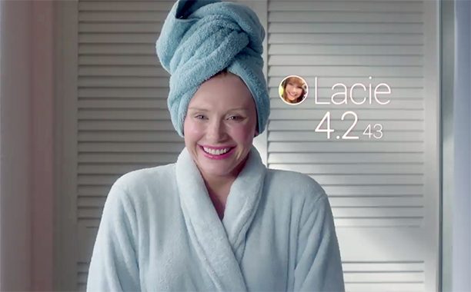
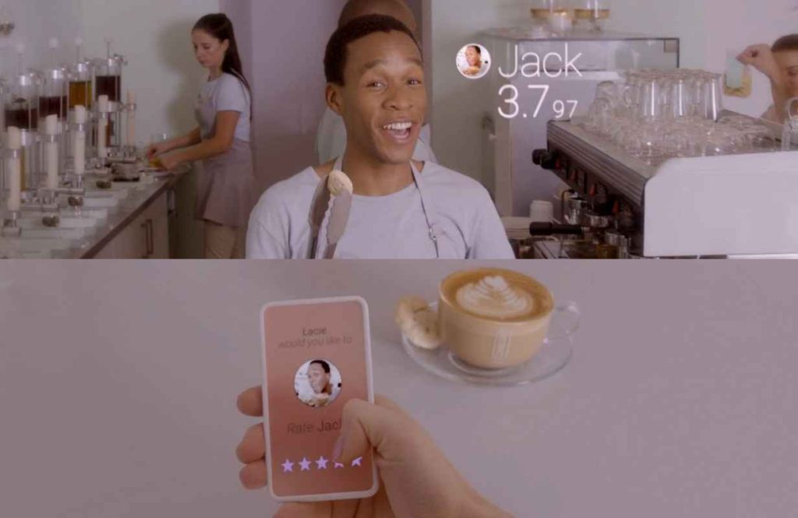
Ethically Using Your Data

Slide 17
IT IS JUST THE BEGINNING...

Slide 18
Concepts and Approaches of ML

Slide 19
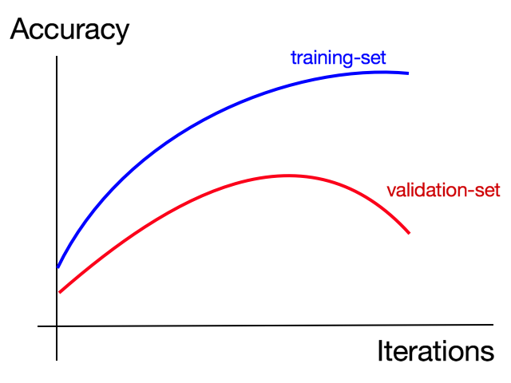
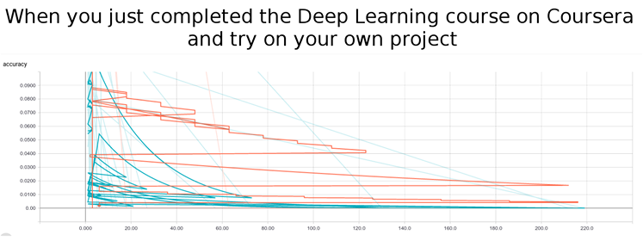
Expectation
Reality

Slide 20
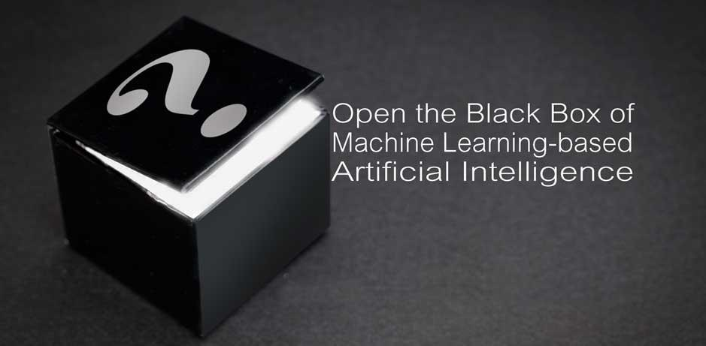
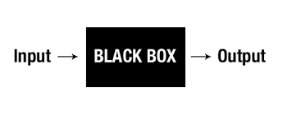
Machine Learning is not a black box!

Slide 21
How does machine learn?
Problem Based Learning :)
Supervised Learning
Semi-supervised Learning
Reinforcement Learning
Unsupervised Learning
Notes:
Supervised learning: (also called inductive learning) Training data includes desired outputs. This is spam this is not, learning is supervised.
Unsupervised learning: Training data does not include desired outputs. Example is clustering. It is hard to tell what is good learning and what is not.
Semi-supervised learning: Training data includes a few desired outputs.
Reinforcement learning: Rewards from a sequence of actions. AI types like it, it is the most ambitious type of learning.

Slide 22
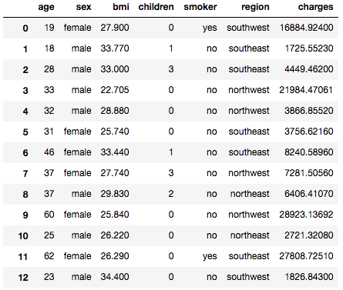
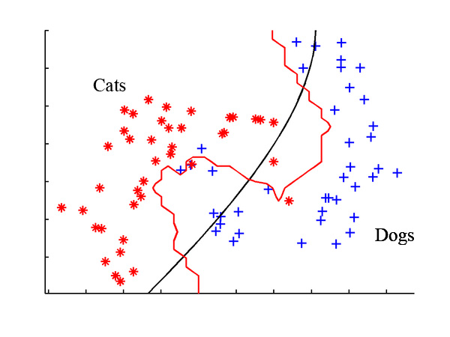
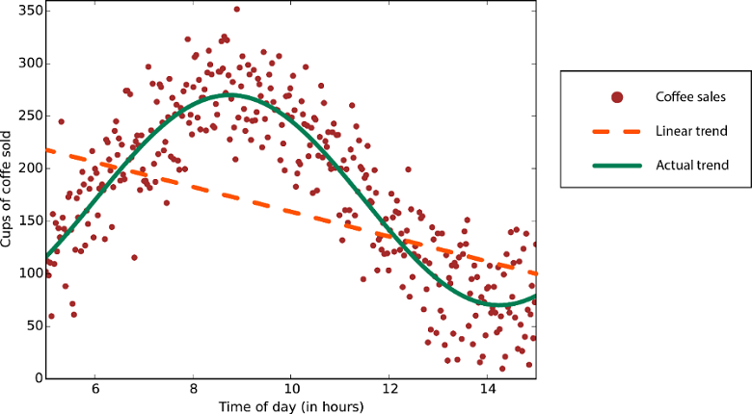
Supervised Learning
Classification
Binary labels
Multiple labels
Regression

Slide 23
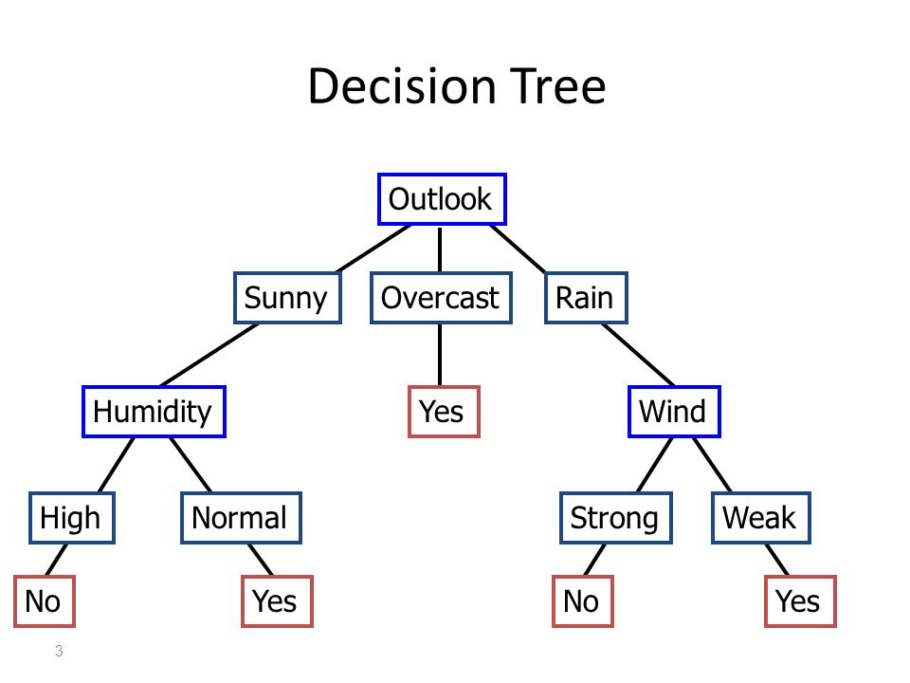
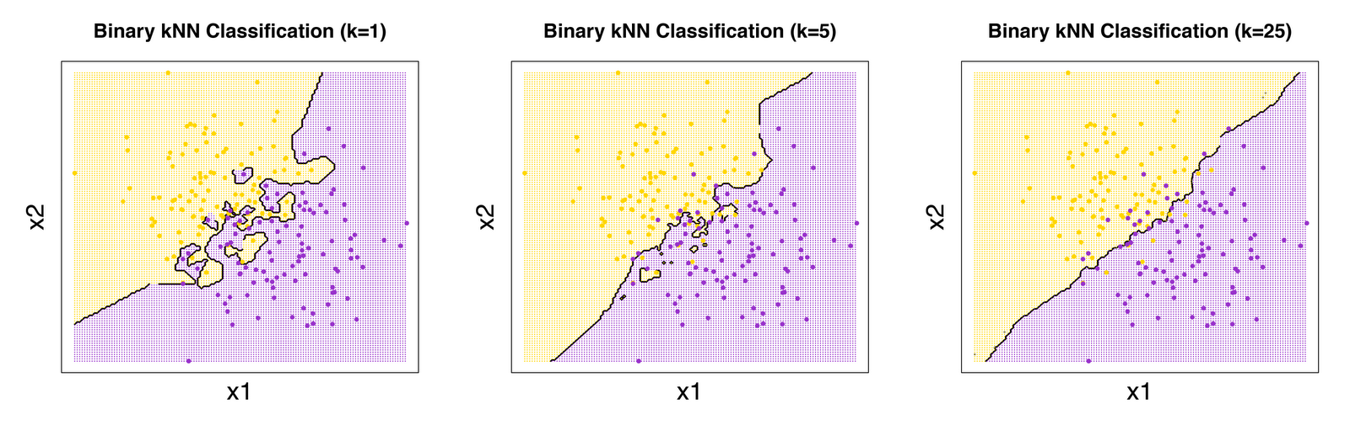
Approaches of Supervised Learning
Ensemble:
Boosting
Bagging
Stack generalization
Single:
K-nearest neighbor
Decision Tree
Support Vector Machine
Neural Network
… …

Slide 24
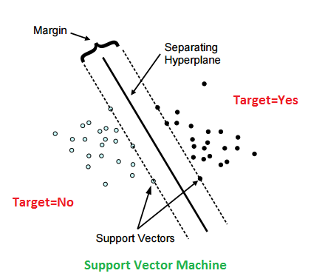

Linear & Non-linear SVM

Slide 25
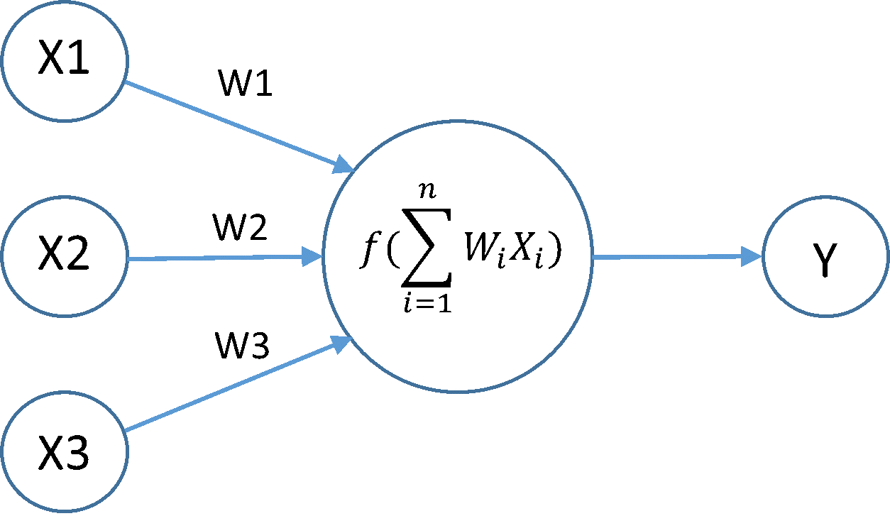
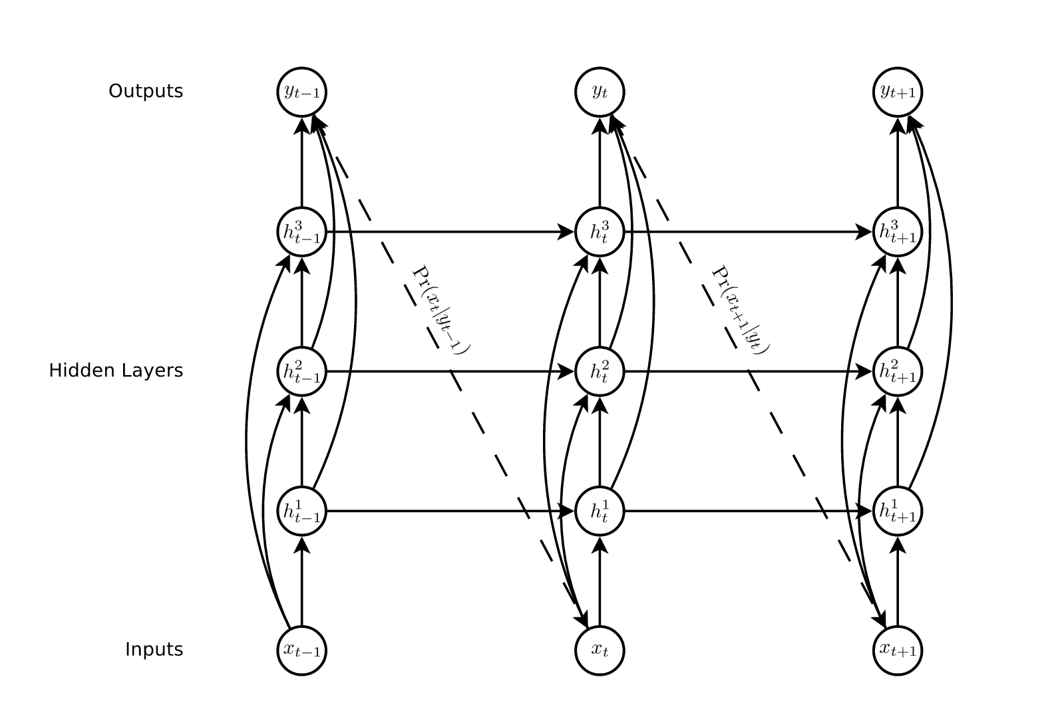
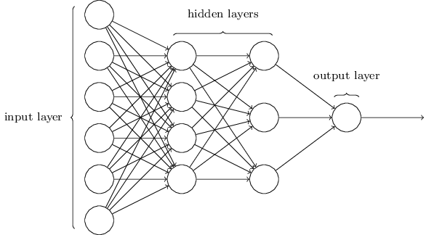
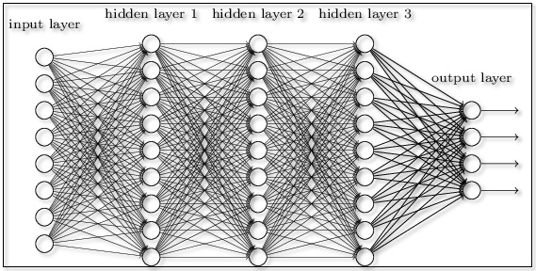
Neural networks

Slide 26
How does machine learn?
Supervised Learning
Semi-supervised Learning
Reinforcement Learning
Unsupervised Learning

Slide 27
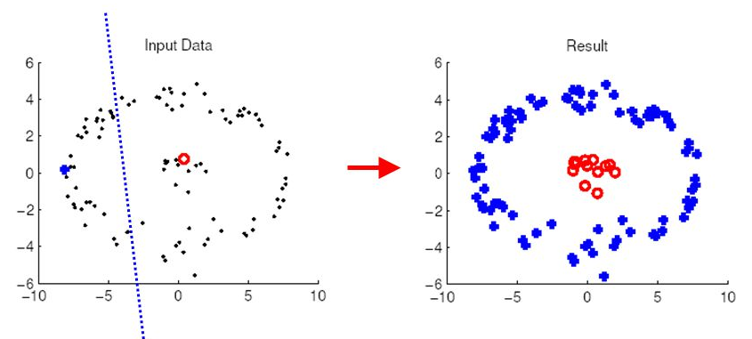
Semi-supervised Learning
Num of unlabeled data > num of labeled data
Input-Output Proximity Symmetry
Relatively Simple Labeling & Low-Dimension Nature of the Problem

Slide 28
How does machine learn?
Supervised Learning
Semi-supervised Learning
Reinforcement Learning
Unsupervised Learning

Slide 29

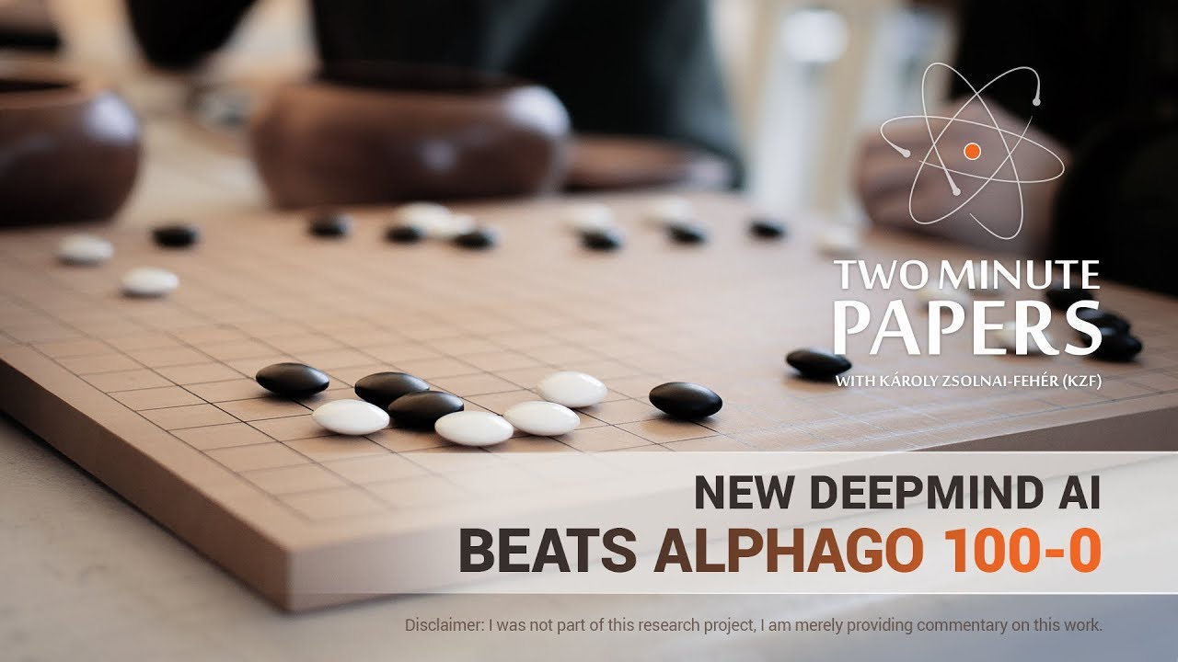
Reinforcement Learning

Slide 30
How does machine learn?
Supervised Learning
Semi-supervised Learning
Reinforcement Learning
Unsupervised Learning

Slide 31
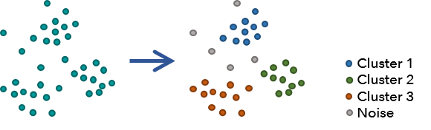
Unsupervised Learning
Clustering
Anomaly Detection
Association rules (Market Basket Analysis)

Slide 32


How about recommendation system ?

Slide 33
What is my problem? How my data looks like? Why do I want to use Machine Learning? Which method I think fits better to my data?

Slide 34
Question?
Lunch Break

Slide 35
Afternoon Agenda:
13:00 - 13:20 Use cases
13:20 - 14:20 Hands-on
14:20 - 15:00 Discussion and closing

Slide 36
Practice:
You are free to choose:
Personal medical costs
Crime and population in Netherlands
Across-national health Outcome

Slide 37
Apply ML to your field!

Slide 38
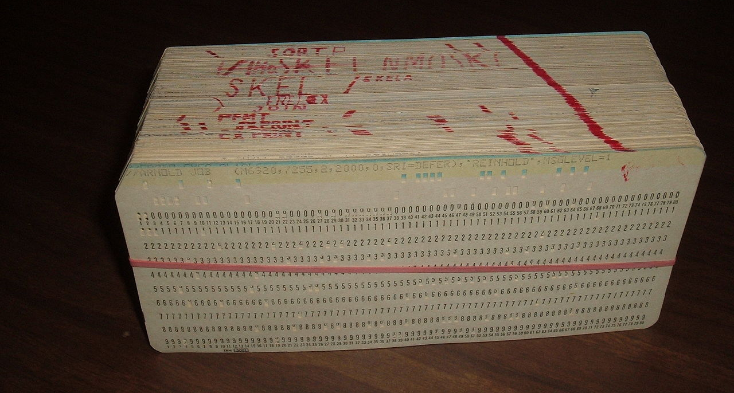
Punch(ed) Card

